Slide 1
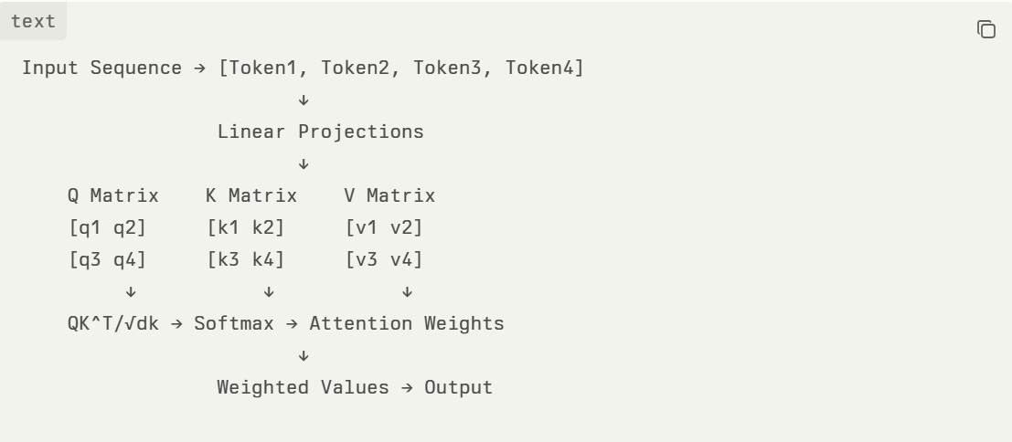
Self-Attention Mechanism - The Core Innovation
Mathematical Foundation
The self-attention mechanism computes attention weights using the scaled dot-product formula:
Attention(Q,K,V)=softmax(QKTdk)VAttention(Q,K,V)=softmax(dkQKT)V
Where:
Q (Query): What information we're looking for
K (Key): What information is available
V (Value): The actual information content
d_k: Dimension of key vectors (scaling factor prevents saturation)
Key Technical Insights
Parallelization: Unlike RNNs, all positions computed simultaneously
Scaling Factor: √d_k prevents softmax saturation for large dimensions
Multi-Head: Multiple attention heads capture different relationship types

Slide 2
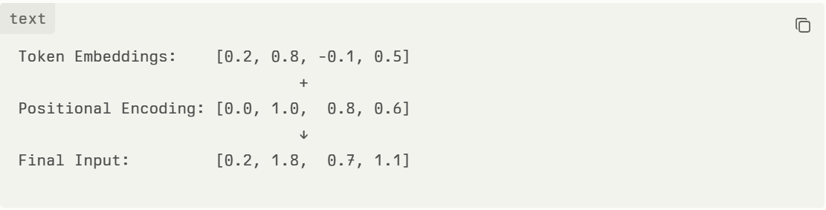
Positional Encoding- Injecting Sequence Order
Since transformers lack inherent position awareness, sinusoidal positional encoding provides sequence information:
PE(pos,2i)=sin⁡(pos100002i/dmodel)PE(pos,2i)=sin(100002i/dmodelpos)
PE(pos,2i+1)=cos⁡(pos100002i/dmodel)PE(pos,2i+1)=cos(100002i/dmodelpos)
Where:
pos: Position in sequence
i: Dimension index
d_model: Model dimension (typically 512)
Mathematical Properties
Linear Relationships: Position pos+k can be expressed as linear combination of position pos
Trigonometric Identity: sin⁡(α+β)=sin⁡αcos⁡β+cos⁡αsin⁡βsin(α+β)=sinαcosβ+cosαsinβ
Relative Position: Model learns relative distances between tokens

Slide 3
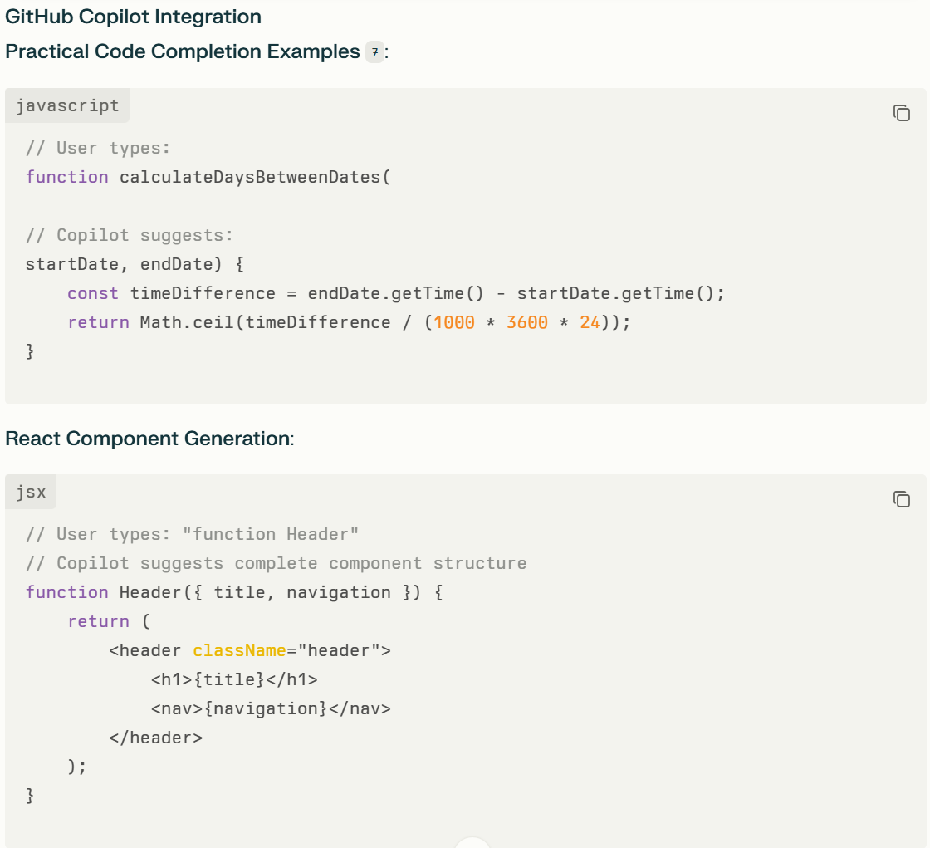
Real-World Impact - CodeLlama & GitHub Copilot
Transformer-Powered Code Generation
CodeLlama Architecture5:
Model Sizes: 7B, 13B, 34B parameters
Training Data: 100GB of code-specific datasets
Specialization: Code Llama-Python, Code Llama-Instruct variants
Technical Enablers
Self-Attention Benefits:
Context Awareness: Understands relationships between function parameters and implementation
Long-Range Dependencies: Connects variable declarations with usage patterns
Parallel Processing: Analyzes entire code context simultaneously
Positional Encoding Impact:
Code Structure: Maintains understanding of indentation and block structure
Syntax Relationships: Preserves order-dependent programming constructs
Sequential Logic: Enables proper control flow suggestions

